Slide 1
Robotics Kinematics
BRAC University

Slide 2
Basics of Robotics Kinematics
Kinematics comes from two Greek roots:
Kine → motion
Matics → related to study or analysis
So, kinematics literally means the study of motion.
In robotics, kinematics answers a very specific and practical question:
How does the motion of joints translate into the motion of the robot’s end-effector?

Slide 3
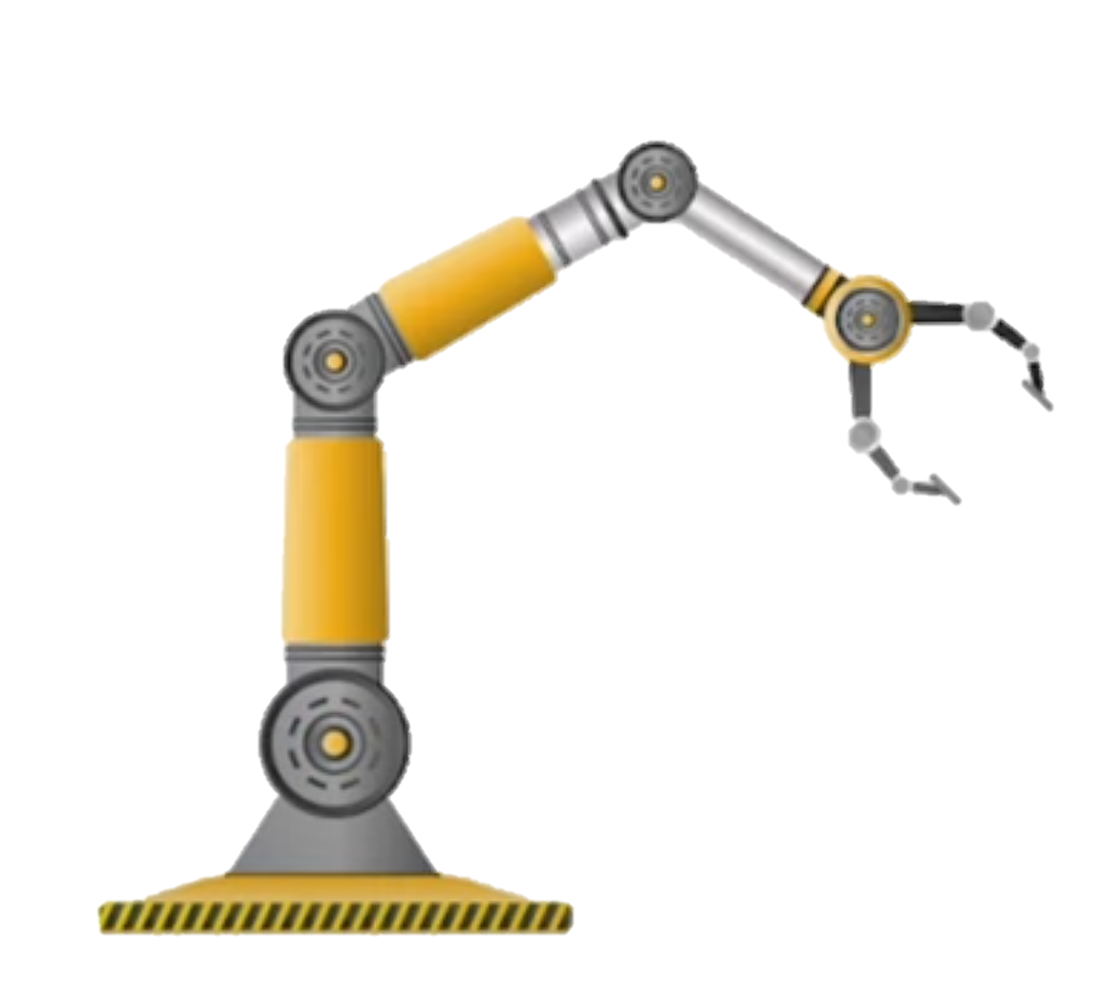
Basics of Robotics Kinematics
Robot kinematics deals with the analytical study of the geometry of motion of a manipulator with respect to a fixed reference coordinate system without regard to the force that causes the motion.
Anatomy divided into base, links, joints and end-effector.
Links: The rigid segments between the joints.
Joints: The movable connections between links, which can be rotational (revolute) or translational (prismatic).
End-Effector: The tool at the end of the manipulator, designed to interact with the environment to achieve certain goals (e.g., grippers, welders, sensors).
Actuators and Sensors
Links
Base Link

Slide 4
Basics of Robotics Kinematics
Robot kinematics deals with the analytical study of the geometry of motion of a manipulator with respect to a fixed reference coordinate system without regard to the force that causes the motion.
Anatomy divided into base, links, joints and end-effector.
Links: The rigid segments between the joints.
Joints: The movable connections between links, which can be rotational (revolute) or translational (prismatic).
End-Effector: The tool at the end of the manipulator, designed to interact with the environment to achieve certain goals (e.g., grippers, welders, sensors).
Actuators and Sensors
Joints

Slide 5
Basics of Robotics Kinematics
Robot kinematics deals with the analytical study of the geometry of motion of a manipulator with respect to a fixed reference coordinate system without regard to the force that causes the motion.
Anatomy divided into base, links, joints and end-effector.
Links: The rigid segments between the joints.
Joints: The movable connections between links, which can be rotational (revolute) or translational (prismatic).
End-Effector: The tool at the end of the manipulator, designed to interact with the environment to achieve certain goals (e.g., grippers, welders, sensors).
Actuators and Sensors
End Effector

Slide 6
Types of Joints
Based on Mobility
Active Joints – Can move, can change angles
Passive Joints – Rigid. Cannot move, cannot change angles.
Based on type of movement (applicable for active joints)
Prismatic Joints (P-joint) – Allows linear/sliding motion along a single axis (1 DoF)
Revolute Joint (R-Joint) – Allows rotational motion around a single axis (1 DoF)

Slide 7
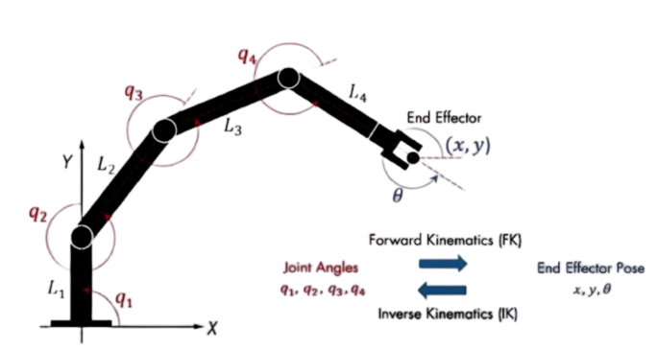
Types of Kinematics
1. Forward/Direct Kinematics – We want to know the final position of the end effector due to the movement of the joints.
2. Backward/Inverse Kinematics – Given the final position of the end effector, we want to know the angle of the joints.
Joint angles
x, y, θ
x, y, θ
Joint angles

Slide 8
Basics of Robotics Kinematics
In this chapter we study how a robot arm moves in space and how joint angles relate to the position of the end-effector.
We will build everything using pure trigonometry before moving to the DH-parameter method in the next section.
This chapter is divided into three parts:
Forward Kinematics (FK) using Trigonometry.
Inverse Kinematics (IK) using Trigonometry.
Forward Kinematics (FK) using Denavit–Hartenberg (DH) Parameters.

Slide 9
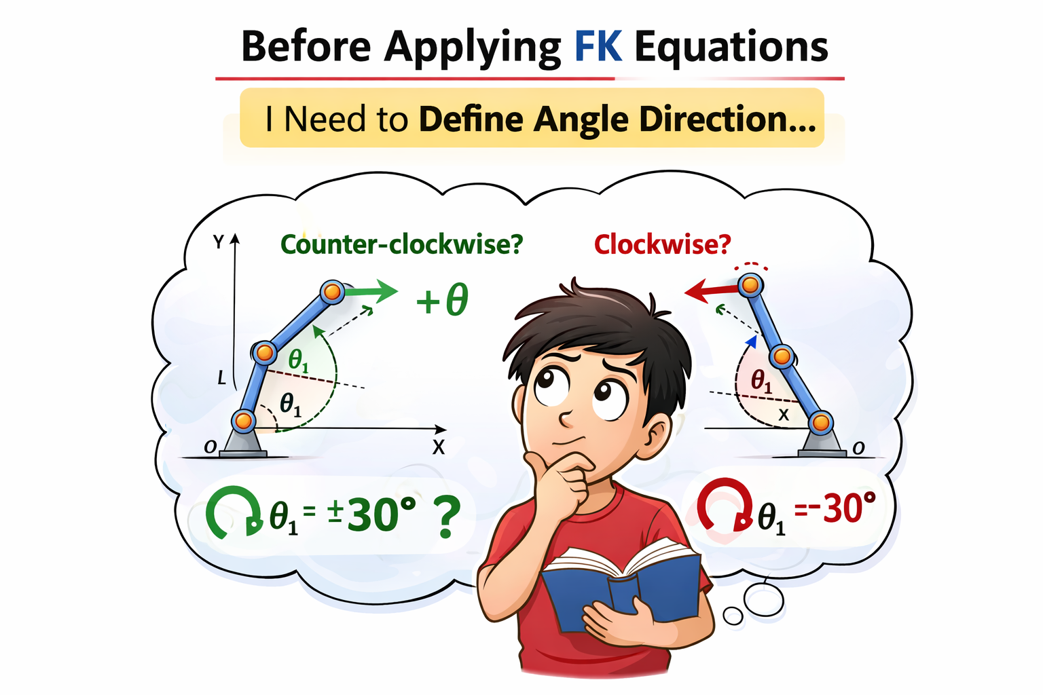
Preliminaries for Forward Kinematics

Slide 10
Angle Sign Convention
L_{n+1}
An angle is defined by two positions: a source (initial) position and a final (end) position.
The direction of rotation from the initial to the end position determines the sign of the angle:
Counter-ClockWise (CCW) is positive (+)
ClockWise (CW) is negative (−)
L_{n}

Slide 11
[Example] Angle Sign Convention
L_{n+1}
Here,
L_{n} : Initial line or link
L_{n+1}: End line or link
So, the arrow describes the direction of the angle, the tail part of the arrow is end point.
Therefore, the direction: counter-clockwise (CCW).
L_{n}
θ
θ will be positive

Slide 12
[Test] Angle Sign Convention
CCW
CW
CCW
CW
A
B
Here, the dotted line (---) is the initial line.
What will the direction of A and B figure?

Slide 13
[Result] Angle Sign Convention
CW
CCW
A
B
Fig. A has negative angle
Fig. B has positive angle

Slide 14
Forward Kinematics
Using Trigonometry

Slide 15
Forward Kinematics using Trigonometry
P (x,y)
Consider a 3R Robot Manipulator consisting,
Link lengths - L₁, L₂, L₃
Revolute Joints - θ₁, θ₂, θ₃​
The motion of the manipulator is restricted to the two-dimensional XY-plane
Each joint angle is defined relative to the immediately preceding link, rather than with respect to the global reference frame. Specifically:
θ₁​ is measured with respect to the global X-axis
θ₂​ is measured relative to Link 1
θ₃​ is measured relative to Link 2
Our GOAL is to find the location of the end-effector P(x,y)
L₃
Y
L₂
θ₃
θ₂
L₁
θ₁
X
3R Planar Robot
https://robotics101-viscircuit.web.app/robotics/dh-model

Slide 16
Single-Link Planar Robot
Consider a single rigid link of length L₁​ connected to the base by a revolute joint with given angle θ₁​, measured from the global X-axis.
Using trigonometric formulas, the coordinates of the link endpoint are given by:
x = L₁cos⁡θ₁
​y = L₁sin⁡θ₁
Y
P (x,y)
L₁
y
θ₁
X
x

Slide 17
Two-Link(2R) Planar Robot
Now consider the addition of a second link of length L₂​, connected to the first link by a revolute joint θ₂
From the figure,
x​ = L_{1​}cosθ₁​ + L₂​cosθ₂​’ [ x₁ + x₂ ]
y = L₁sin⁡θ₁ + L₂sin⁡θ₂’ [ y₁ + y₂ ]
P (x,y)
Y
L₂
θ₂’
y₂
L₁
x₂
θ₂
90-θ₁
y₁
θ₁
Considering the value of θ₂​’, we get:
x​ = L₁​cosθ₁​+ L₂​cos(-180 + θ₁+ θ₂)
y = L₁sin⁡θ₁+ L₂sin⁡(-180 + θ₁+ θ₂)
x₁
X
θ₂’ = θ₂​- 90°- (90 - θ₁)
= θ₂​- 90°- 90 + θ₁
= -180 + θ₁+ θ₂

Slide 18
Three-Link Planar Robot (3R-2D)
P (x,y)
Now, if θ₃ joint is also added, we get:
x​ = L₁​cosθ₁​+ L₂​cos(-180 + θ₁+ θ₂) + L₃cos(-360 + θ₁+ θ₂+ θ₃)
y = L₁sin⁡θ₁+ L₂sin⁡(-180 + θ₁+ θ₂) + L₃sin(-360 + θ₁+ θ₂+ θ₃)
L₃
Y
L₂
θ₃
θ₂
L₁
These equations give the end-effector position directly from the given angles.
θ₁
X
3R Planar Robot
This method works, but it becomes messy as the number of joints increases. Each new joint introduces more angle bookkeeping and geometric reasoning.

Slide 19
Forward Kinematics using Trigonometry [Extension]
P (x,y)
L₃
θ₃
Let’s say, angles are given with respect to previous link’s length across [joint angle: in DH parameter (more details are coming in DH part)]
If we compare this with the previous figures, these angles are different.
We can modify the previous equations if we want to convert this to the earlier format.
Y
θ₂
L₂
L₁
θ₁
X
3R Planar Robot

Slide 20
Forward Kinematics using Trigonometry [Extension]
Here,
θ₂’ = 180 + (-θ₂​) [as θ₂ is CW]
θ₃’ = 180 + (+θ₃) ​[as θ₃ is CCW]
P (x,y)
L₃
θ₃
Y
θ₂
L₂
θ₃’
If we plug these into the previous equation, we get:
x​ = L₁​cosθ₁​+ L₂​cos(θ₁- θ₂) + L₃cos(θ₁- θ₂+ θ₃)
y = L₁sin⁡θ₁+ L₂sin⁡(θ₁- θ₂) + L₃sin(θ₁- θ₂+ θ₃)
L₁
θ₂’
θ₁
X
3R Planar Robot
Note: notice that θ₁​ is (+)ve, θ₂ is (-)ve, θ₃ is (+)ve. In the DH parameter we will define these angles, JOINT ANGLE

Slide 21
Forward Kinematics using Trigonometry
P (x,y)
L₃
Y
L₂
θ₃
θ₂
L₁
θ₁
X
This manipulator operates only in a single plane, does not operate in the 3 axis altogether

Slide 22
3R Planar Robot (3D)
P(x,y,z)
Z
The figure illustrates a where the motion of the end-effector is not restricted to XY plane.
The base joint of this robot is configured differently, enabling rotation about a Z-axis. This modification allows the robot to access points in the XYZ-workspace.
GOAL - Find the location of P(x,y,z)
L₃
L₂
θ₃
θ₂
h
X
This robot can be conceptually decomposed into:
A base joint that provides azimuthal motion
A planar 2R arm mounted on the rotating base
θ₁
Y

Slide 23
3R Planar Robot (3D)
P(x,y,z)
Z
To analyze and compute the kinematics effectively, two orthogonal viewpoints are required:
Top View (XY-plane)
  Captures the effect of the base rotation
  Used to determine the projection of motion in the horizontal plane
Side View (XZ-plane)
  Captures the motion of Link 2 and Link 3
  Used to compute vertical displacement and radial reach
L₃
L₂
θ₃
θ₂
h
X
θ₁
Y

Slide 24
Side View
P(x,y,z)
Z
We can solve the 2R Planar part, using the earlier concepts of this lecture. The equations we get are:
d = L₂​cosθ₂​+ L₃​cos(-180 + θ₂+ θ₃)
z = L₂sin⁡θ₂+ L₂sin⁡(-180 + θ₂+ θ₃) + h
L₃
L₂
θ₃
z
θ₂
h
NOTE: When analyzing the robot from the side view, the horizontal coordinate obtained does not represent the true x-coordinate of the end-effector. Instead, it represents the projection (denoted as d) of the arm in the horizontal plane.
X
d
(projection)

Slide 25
Top View
Y
From the top view, we simply see how the arm is rotated around the base and how the projected length d spreads into the X and Y directions.
The real coordinates,
x​ = dcosθ₁
x = (L₂​cosθ₂​+L₃​cos(-180 + θ₂ + θ₃))cosθ₁
and
y = dsin⁡θ₂
y = (L_{2​}cosθ₂​+L₃​cos(-180 + θ₂ + θ₃))sin⁡θ₂
P(x,y,z)
d
y
θ₁
x
X

Slide 26
Common confusion
Top View
Z
P(x,y,z)
Y
L₃
P(x,y,z)
Side View
L₂
θ₃
d
z
y
θ₂
h
θ₁
X
x
X
d
(projection)
From the side view, d is just the horizontal reach of the arm, meaning how far the arm extends forward, ignoring whether it goes left or right.
This view hides the rotation of the base, so it loses direction information in the horizontal plane.
That’s why we cannot get the real x-value from the side view alone. We only get the length, not where it points.

Slide 27
3R-3D Planar Robot [Extension]
If the angles are given with respect to previous link’s length across
Z
P(x,y,z)
Z
P(x,y,z)
L₃
L₃
L₂
θ₃
L₂
θ₃
θ₂
θ₂
h
h
X
X
θ₁
θ₁
Y
Y
x = ?
y = ?
z = ?
x = (L₂​cosθ₂​+L₃​cos(θ₂+ θ₃))cosθ₁
y = (L₂​cosθ₂​+L₃​cos(θ₂ + θ₃))sinθ₁
z = L₂​sinθ₂​+L₃sin(θ₂+ θ₃) + h

